Slide 1
Research information systems and interoperability
Aija Kaitera
Administrator / Research Information System
Chair / ORCID working group in Finland
University of Helsinki

Slide 2
Current Research Information Systems
Process
Value
Target / Audience
Funding application
Evidence of excellence
Funding body
Communication
Potential collaborator Fellow scientist
Future potential
Past results
Open Science
The world
Recruiting
Trends Weaknesses Strengths Benchmarking
Academic leaders
Government
Funding body
Strategic management
Ranking body

Slide 3
CRIS Current Research information system
Persons, organisations, research infrastructure, funding, project
Publications, journals, publishers, other scientific activities, research data
Can store full texts and data, usually linked with repositories
Idenfiers: ORCID ID, ResearcherID, Scopus Author ID; DOIs, Wos UT
Closed system even though has some level of interoperability
Vendors: Pure (Elsevier), CONVERIS (Thomson Reuters)…
Notes:
Automated webpages for scientists, research groups, units
RSS feeds, webservices
Research management to view current status
Data collecting and statistics for annual reporting and other targets
Funding source identification and smoother application/reporting process

Slide 4
Researchers point of view
My Funding
My Publications
My Activities
Researcher
My Awards
My Projects
My Data

Slide 5
Current and Future information flow
Statistics FI
National portal
Future
Researcher’s use cases
Join experts portals w/ data
Use data elsewhere
Get metrics/analytics
…
Academy of Finland reporting
National stats, National API
MyData
Institutional Repository
University stats
University
web sites
CRIS
Users
Personnel data
Fundings
Organisations
WoS, ArXiv
Fennica
Partly automated
ORCID
Other manually
submitted data
Current

Slide 6
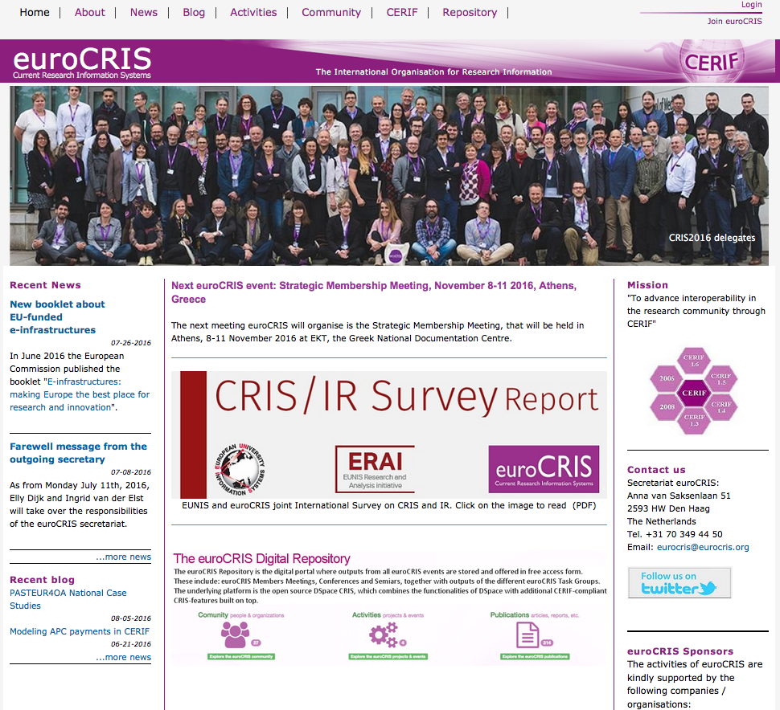
http://www.eurocris.org/

Slide 7
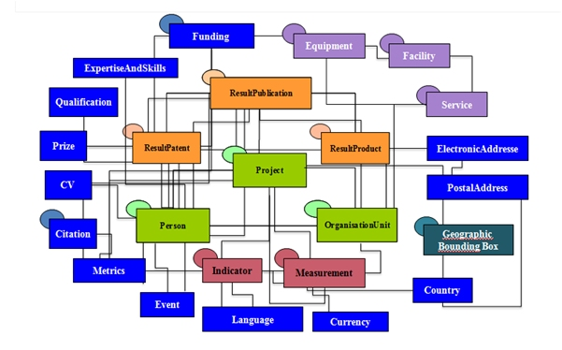
CERIF MODEL
http://eurocris.org/sites/default/files/presentations/Presentation_CERIF_1.ppsx

Slide 8
Thank you
Aija Kaitera
aija.kaitera@helsinki.fi
+358 050 380 3820
Twitter: aijakaitera

